Slide 1
Working Capital
Concepts of working capital;
Types of working capital;
Factors affecting the size of working capital;
Working capital management and its significance;
Operating cycle,
Cash conversion cycle and
Computing the amount of working capital requirement.

Slide 2
Concepts of Working Capital
Working Capital (to meet day to day operation)
Fixed Capital ( to finance fixed assets)
Working capital is also called circulating capital
CCC= ICP +RCP – PDP, where ICP+RCP is operating cycle.

Slide 3
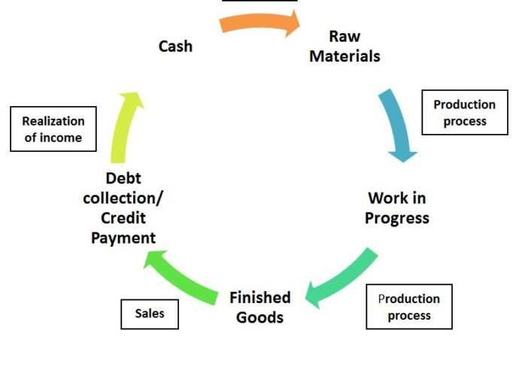
Concepts of Working Capital

Slide 4
Concept
Gross Concept:
Gross working capital
Total amount of current assets
Relevant for new company compare to existing because new company should identify level of inventory, cash and receivable.
Is higher GWC= high liquidity ??
NO, because we have to compare assets and liability to find liquidity.

Slide 5
Concept
ii. Net Concept
Net working capital ( i.e. CA- CL)
Part of investment in CA that is financed by long-term funds
Higher NWC = Higher Liquidity
Relevant to existing company as creditors wants high CA compare to CL.
iii. Zero Concept
WC= Inventory + Receivable – Payable results ZERO
Inventory and Receivable are components to generate sales

Slide 6
Concept
Net Working Capital is a part of short term fund (T or F)
False because if CL is insufficient to meet CA it is financed through Long term fund
NWC (i.e. CA-CL ) can be +ve or –ve
+ve NWC (CL will not finance CA)
-ve NWC (CL more that CA)

Slide 7
Example Problem
Example 1. If a firm has a cash balance of Rs 50,000, debtors of Rs. 70,000 and inventory of Rs 100,000, then calculate the gross working capital for the firm.
Example 2. If a firm has a cash balance of Rs. 100,000, debtors of Rs 150,000 and current liabilities of Rs 200,000, then calculate the net working capital of the firm.

Slide 8
Types of Working Capital
Permanent (Fixed) Working Capital
Minimal working capital to be maintained at all times
Remains same through out the year
Never will be zero
B. Variable (Seasonal) Working Capital
Fluctuating working capital over and above the permanent working capital
Increase or decrease with changes in sales / production

Slide 9
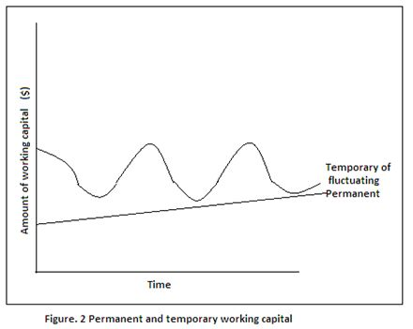
Types of Working Capital
Month | Total WC | Permanent WC | Temporary WC
Jan | 50,000 | 20,000 | 30,000
Feb | 60,000 | 20,000 | 40,000
Mar | 20,000 | 20,000 | 0
April | 90,000 | 20,000 | 70,000
May | 30,000 | 20,000 | 10,000

Slide 10
Factors Affecting Size of Working Capital
1. Volume of Sales
High Sales = High WC
Low Sales =Low WC
2. Seasonal and Cyclical Factors
Off season (low)
Peak season (High)
Boom(high)
Recession (low)
3. Firm’s credit policy
Liberal (high credit allowed so high WC)
Tight (low credit allowed so low WC)
4. Working Capital Policy
Aggressive (Low CA= Low WC)
Conservative ( High CA = High WC)
Moderate (in between)
5.Nature and size of Business
Manufacturing ( low WC ; long term assets)
Trading (High WC, Current assets is high)
Small Size ( Low WC ; low transaction)
Large Size ( High WC; high transaction)

Slide 11
Factors Affecting Size of Working Capital
6. Cost and Time involved in Manufacturing Process
High Input cost ( High WC; to buy raw materials)
Low Input Cost (Low WC)
Long Processing Time (High WC)
Short Processing Time (Low WC)
7. Cash Conversion Cycle
Long (High)
Short (Low)
8. Turnover of circulating capital
Fast task within operating cycle (Low WC)
Slow task within operating cycle (High WC)
9. Growth and Expansion Phase
High Growth ( High WC)
Low Growth (Low WC)
10. Predictability of Cashflow
Certainty ( Low WC)
Uncertainty (High WC)
11. Use of Technology
New Technology (Low WC)
Old Technology (High WC)
12. Access to money Market
Good Access ( Low WC)
Poor Access (High WC)

Slide 12
Working Capital Management
Management of current assets investment and their financing
Covers all decision of an organization involving cash flows in short-run with emphasis on management of investment in firm’s current assets and their financing
Maintain the CA and CL at a point, which represents the most satisfactory level of working capital.
Excessive CA= more use of long term fund which is costlier than short term funds
Inadequate CA= leads into technical bankruptcy as it becomes unable to satisfy its current obligation timely.
Optimum working capital insists on maintaining a trade-off between profitability and cost associated with CA investment and financing policy of firm

Slide 13
Importance/ Significance of Working Capital Management
Significant part of total assets
Maintaining a desired scale of operation
Maintaining regular cash flow
Survival of firm
Objectives of Working Capital Management:
Smooth working capital operating cycle
Lowest working capital
Minimize rate of interest or cost of capital
Optimal return on current assets investment

Slide 14
Cash Conversion Cycle
Cash conversion cycle refers to the length of time from the payment for purchase of raw materials to the collection of receivables. It indicates the length of time the firm has funds tied up in working capital
CCC=ICP + RCP –PDP
= Operating Cycle – PDP
Where,
ICP= Inventory Conversion Period
RCP= Receivable Conversion Period
PDP= Payable Deferral Period

Slide 15

Operating Cycle

Slide 16
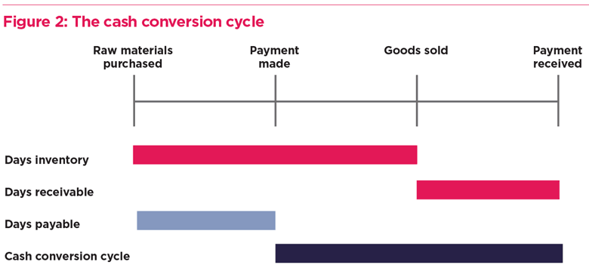
Fig: Cash Conversion Cycle

Slide 17
Cont.
The cycle and length of time gap differ from one organization to another organization even in the same industry as well as other industries.
Trading organizations need not to process raw materials and work in progress into finished products. Therefore the cycle for trading organization will be shorter than manufacturing organization.
Financial enterprises do not have this type of cycle. They are engaged in the business of borrowing and lending. They use different methods than that of manufacturing firms. In this section our focus will be on trading and manufacturing organization
Working Capital Financing requirement or Negotiated financing required=
Daily Production * Cost per unit * CCC
OR
Daily Investment in operating cycle (Working Capital )* CCC

Slide 18
Inventory Conversion Period (ICP)
Length of time required to convert raw materials into finished goods and to sell these goods
ICP = Days in a year / Inventory turnover ratio
OR
Inventory / Cost of goods sold per day
Inventory turnover ratio= Cost of goods sold/ Inventory
or
Sales / inventory

Slide 19
Example Problem
Example 3. Calculate the inventory conversion period in the following cases: Assume 360 days in a year:
A firms annual sales is Rs. 15,000,000 and its cost of goods sold is approximately 80% of sales. It keeps inventory equal to Rs. 1,000,000 at all the times
The sales and cost of goods sold of the firm are Rs. 10,000 and Rs 8,400 respectively. The beginning of year inventory is Rs 1,200 and the end of year inventory is Rs 1,000
A firm has a inventory turnover of 8 times

Slide 20
Receivable Conversion Period(RCP)
Length of time required to convert firm’s receivable into cash. It is also called as Days Sales Outstanding (DSO) or Average Collection Period (ACP)
RCP = Days in a year / Receivable turnover ratio
or
Receivable / Credit sales per day
Receivable turnover ratio= Credit Sales / Receivable

Slide 21
Example Problem
Example 4. Calculate the receivable collection period in the following cases: Assume 360 days in a year:
A firms annual sales is Rs. 15,000,000. The firm has receivables of Rs. 1,000,000.
The sales of the firm is Rs 10,000. The beginning of the year receivable is Rs. 1,200 and the end of year receivable is Rs. 1,000
A firm has a receivable turnover of 10 times
A firm’s annual sales is Rs 1 million, 80% of which are on credit and has a receivable of Rs. 70,000

Slide 22
Payable Deferral Period (PDP)
Length of time between the purchase of raw material and labor and payment of cash for them.
PDP = Days in a year / Payable turnover ratio
Or
= Payable / Cost of goods sold per day
Payable turnover ratio = Cost of goods sold / Payable
Or
= Credit Purchase / Payable
Note: Use average inventory, average receivable and average payable if the opening and closing information are provided by question.
Average = (Opening + Closing) / 2

Slide 23
Example Problem
Example 5. Calculate the Payable Deferred period in the following cases: Assume 360 days in a year:
A firms annual sales is Rs. 15,000,000 and its cost of goods sold is approximately 80% of sales. The firm has account payable of Rs. 900,000
The sales and cost of goods sold of the firm are Rs. 100,000 and Rs 84,000 respectively. The beginning of the year account payable is Rs 10,200 and the end of year account payable is Rs. 10,000
A firm account payable and credit purchase of Rs 20,000 and 450,000 respectively
Example 6.
Suppose it takes a firm an average of 30 days to convert materials and labor and to sell them, and it takes another 20 days to collect on receivables, while 30 days normally laps between receipt of materials and payments for materials and labor
What is firm’s cash conversion cycle ?
Suppose the firm’s daily expenses of Rs 1,500 and cash conversion cycle of 20 days, calculate external financing requirement

